Slide 1
前端網頁 HTML CSS JQuery Kendo
部門 :MISAP
演講者 : Diabee_Chen

Slide 2
課程的目的
HTML CSS Javascript 的了解
JQuery 基本操作 (2/3)
未來面對javascript base 的擴充語言不會畏懼
Kendo UI 的應用和操作(1/3)
Web 運作流程了解

Slide 3
Agenda
Prepare
The Introduction of Front-End
HTML
jQuery
Kendo UI
Workshop 3 (10分鐘介紹)
Notes:
Prepare

Slide 4
Prepare
教育訓練投影片跟kendo元件
jsfiddle (課堂練習)
Chrome browser (介紹debugger tool)
Vs code or Atom or Sublime
Notes:
1. jsfiddle 線上html css javascript 工具
請註冊會員 和 登入
2. Chrome 安裝
F12 or Ctrl+shift+I
3. VS2012 安裝
基本debugger 介紹

Slide 5


Slide 6
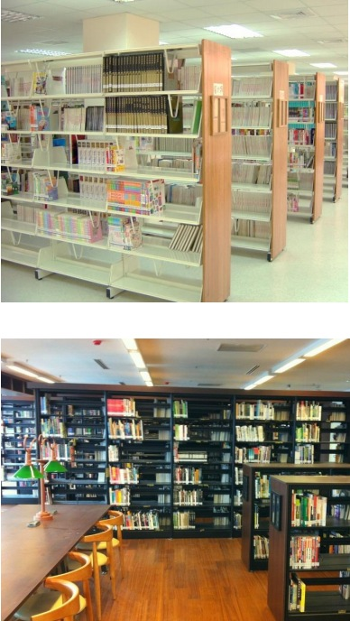
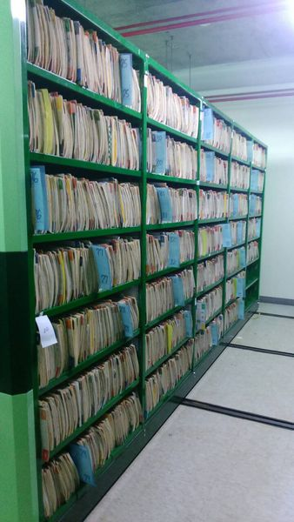
介紹Web的演進
紙本來做資料處理

Slide 7
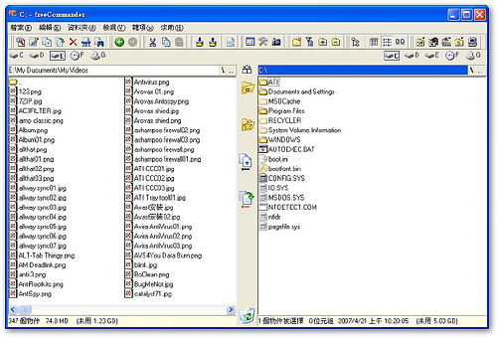

介紹Web的演進
電腦的誕生
利用電腦來做資料處理

Slide 8
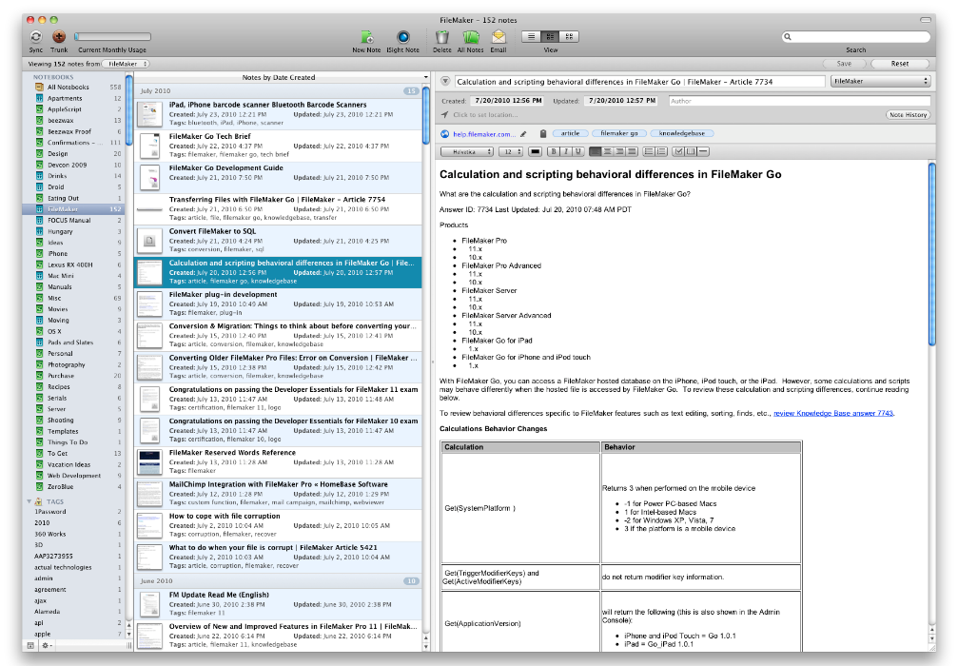
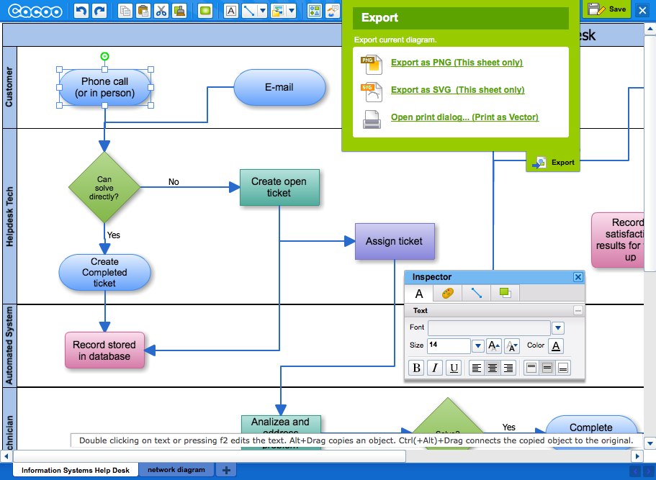
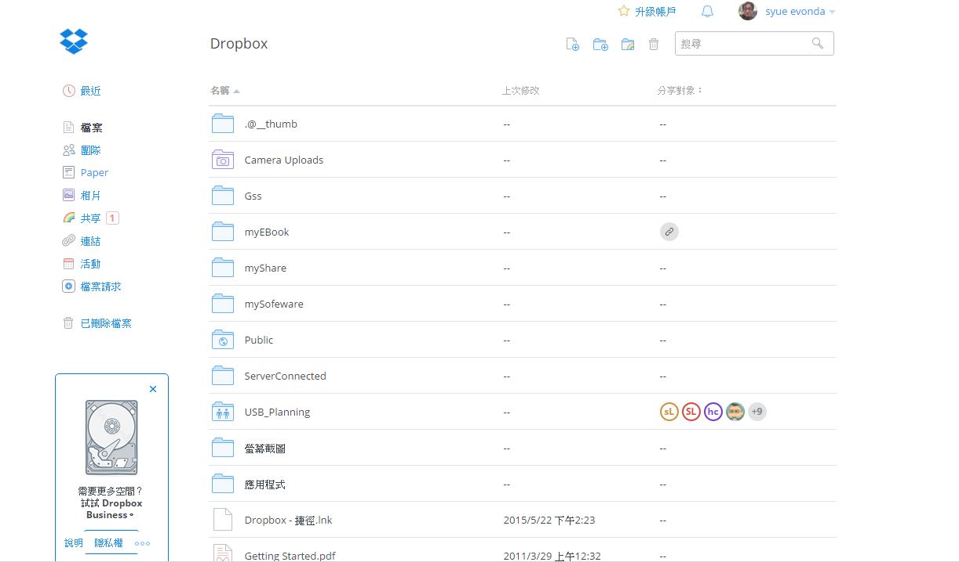
介紹Web的演進
網路的誕生
利用網路來處理資料

Slide 9


What is Front-End(前端) ??
Front-End是軟體系統中直接和用戶交互的部分
Browser 即為一套解析網頁語言的軟體
User 透過 Browser操作系統
Notes:
1. 介紹從以前的應用程式安裝 一直到browser 提供給user去使用來方便操作的一套UI Interface

Slide 10
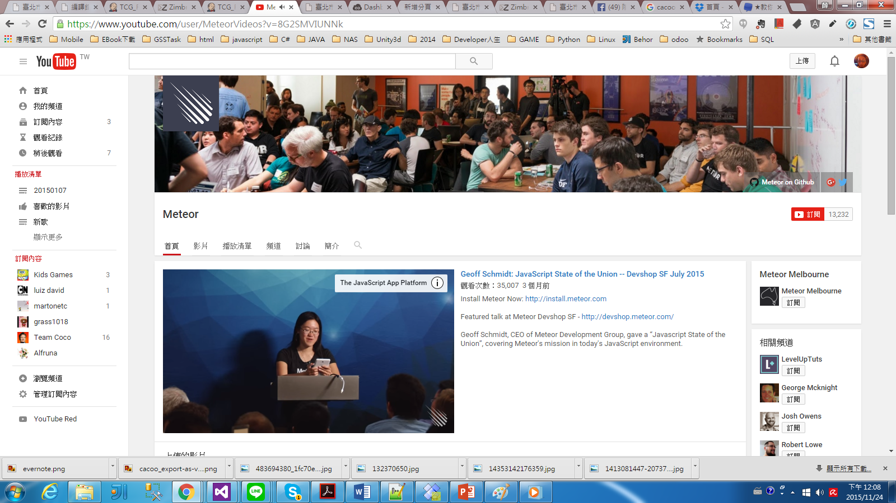
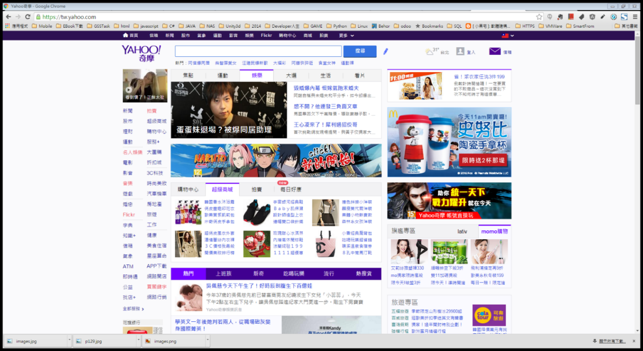
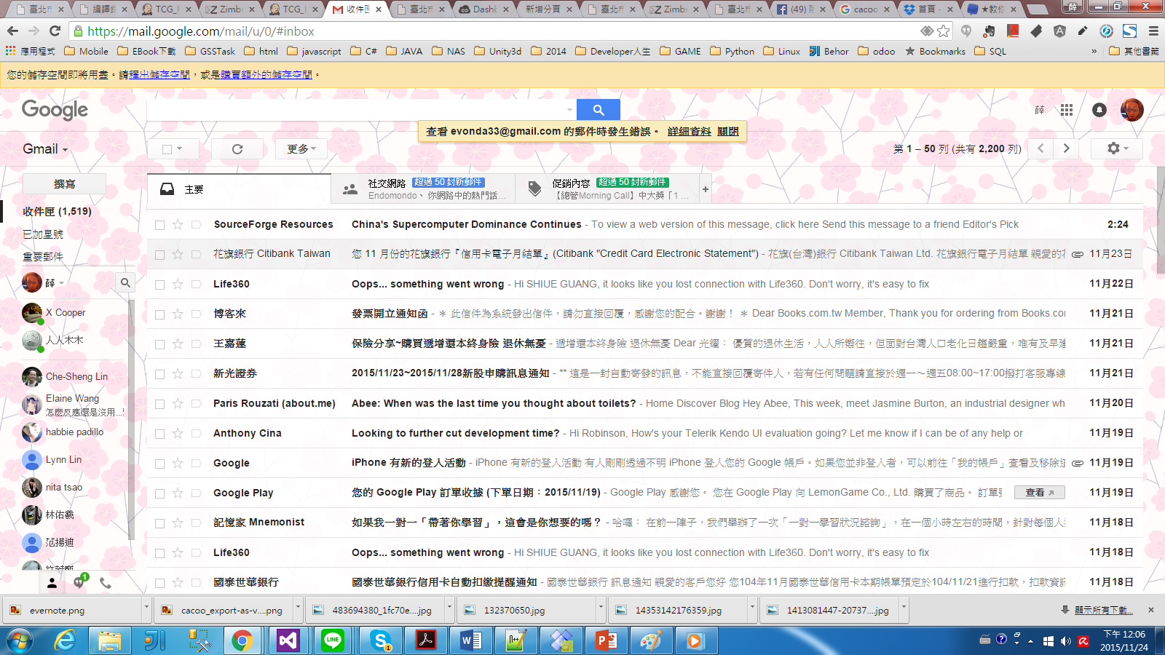
What is Front-End ??
UI(User Interface) :是系統和使用者之間進行互動和資訊交換的媒介，它實作資訊的內部形式與人類可以接受形式之間的轉換。

Slide 11
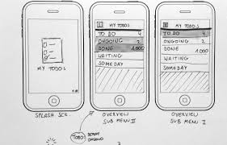
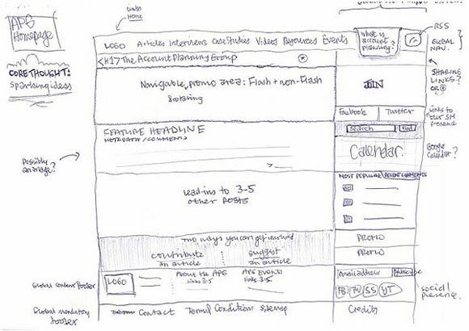
What is Front-End ??
UX(User Experience) :用戶的習慣為基礎，設計出適合甚至更好體驗的產品
It involves a person's emotions and attitudes about using a particular product, system or service.

Slide 12

What is Front-End ??
UX 思考圖

Slide 13
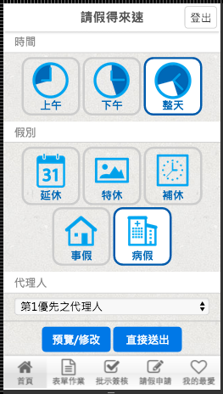
What is Front-End ??
UX 設計的探討

Slide 14
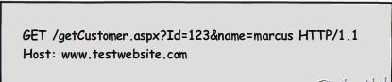
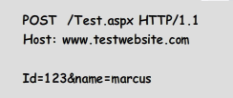
What is Front-End ??
HTTP(HyperText Transfer Protocol)
跟Backend 溝通的一個橋梁(協定)
Get
Post
Notes:
超文件本文傳輸協定

Slide 15
What is Front-End ??
Back-End : 伺服器端的應用服務，例如:Database Web Service , Service etc …
控制著軟體的輸出
PHP , .NET , JAVA , …….etc

Slide 16



What is Front-End ??
Front-End
Back-End
Http協定(Request)
Response(html,js,css,data)

Slide 17
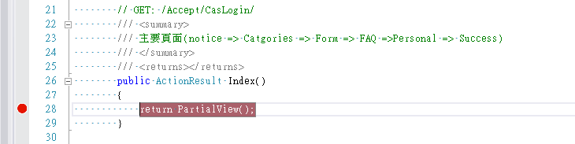
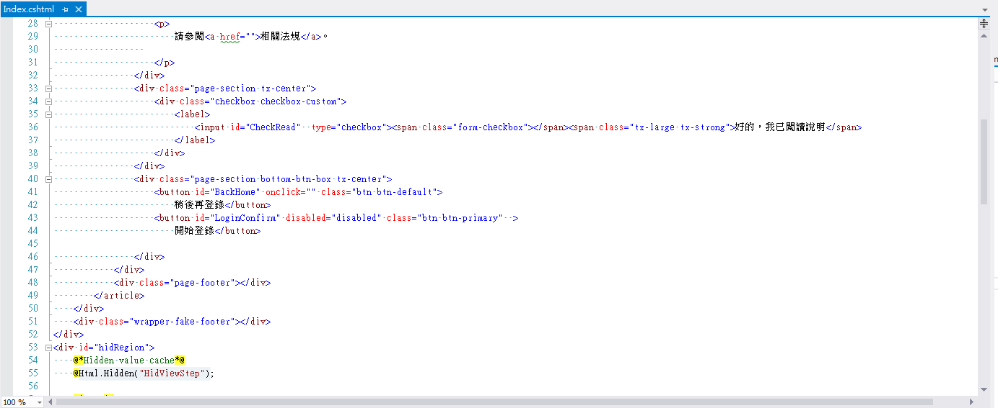
What is Back-End ??
當server收到http request
Http協定(Request)
透過Controller
Response(html,js,css,data)
指定回給user的view

Slide 18
What is Back-End ??
Database
Call Service
Return data
Http協定(Request)
透過Controller
Data Model binding
Response(html,js,css,data)
回傳給user
Notes:
帶一個TCG專案的sample看看

Slide 19
Basic HTTP Code for Response
Successful 2xx
Client Error 4xx
Server Error 5xx

Slide 20
Successful 2xx
201 Created
Any resource is created by server.
200 OK
Any other operation has succeeded.

Slide 21
Client Error 4xx
401 Unauthorized
The operation requires user authentication.
403 Forbidden
The operation is not allowed. (e.g., user authorization failed.)
404 Not Found
The resource is not found.
409 Conflict
A conflict with the current state of the resource. (e.g., access the stale data in database.)
410 Gone (optional)
The resource is marked as deleted or invalid.
412 Precondition Failed
Precondition for Design-By-Contract. (e.g., illegal arguments or data validation failed.)
400 Bad Request
Any other error caused by client.

Slide 22
Server Error 5xx
501 Not Implemented
The operation is not implemented yet.
500 Internal Server Error
Any other error occurred by server. (e.g., the database is dead or database constraint violation occurred.)

Slide 23


Slide 24
Introduction of HTML
發展歷史
HTML
XHTML (eXtensible HyperText Markup Language)
DOM (Domain Object Model)
Notes:
HTML，XML 和 SVG 文件的程式介面。它提供了一個文件（樹）的結構化表示法，並定義讓程式可以存取並改變文件架構、風格和內容的方法。DOM 提供了文件以擁有屬性與函式的節點與物件組成的結構化表示。節點也可以附加事件處理程序，一旦觸發事件就會執行處理程序。 本質上，它將網頁與腳本或程式語言連結在一起。

Slide 25
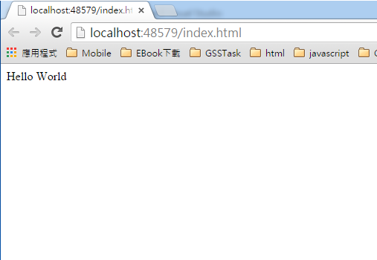
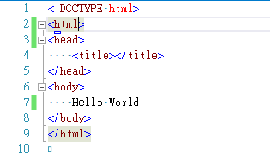
HTML 頁面結構

Slide 26
DOM(Document Object Model)
document (Document) |-html (HTMLHtmlElement) |-head (HTMLHeadElement) | |-title (HTMLTitleElement) | |-首頁 (Text） | |body (HTMLBodyElement) |-h1 (HTMLHeadingElement | |-Hello!World! (Text) | |-a (HTMLAnchorElement) |-test (Text)
<html> <head> <title>首頁</title> </head> <body> <h1>Hello!World!</h1> <a href="index.html">test</a> </body> </html>

Slide 27
HTML標籤介紹
Structured
<body>, <div>, <span>, <ul>, <li>, <table>, <tr>, <td>...
Form
<form>, <input>, <textarea>...
Presentation
<a>, <img>, <title>, <h1>, <h2>, <b>, <i>...
Others
<script> <link>...
go to W3C

Slide 28
Excerise
link
把 Yahoo 改成用Google .
Ex:
https://www.google.com.tw/search?q=總統大選&tbm=nws
https://www.google.com.tw/search?q=總統大選
將範例改成如下 (了解簡單的改html)

Slide 29


Slide 30
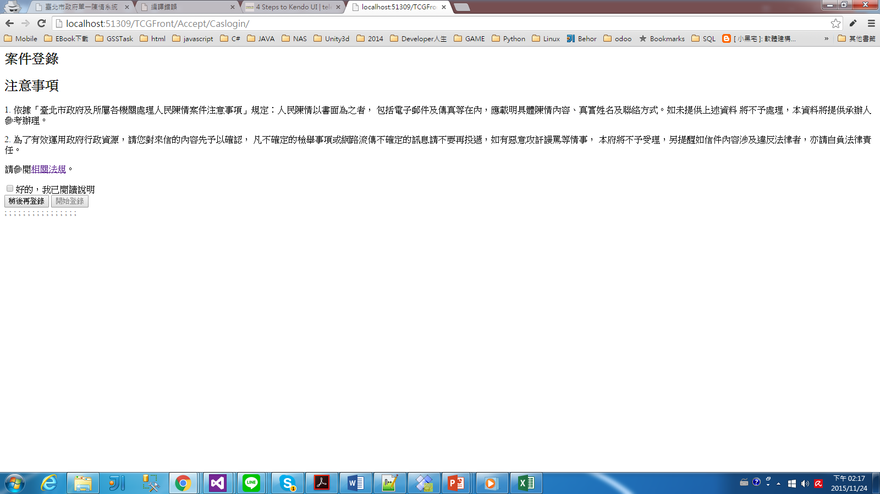
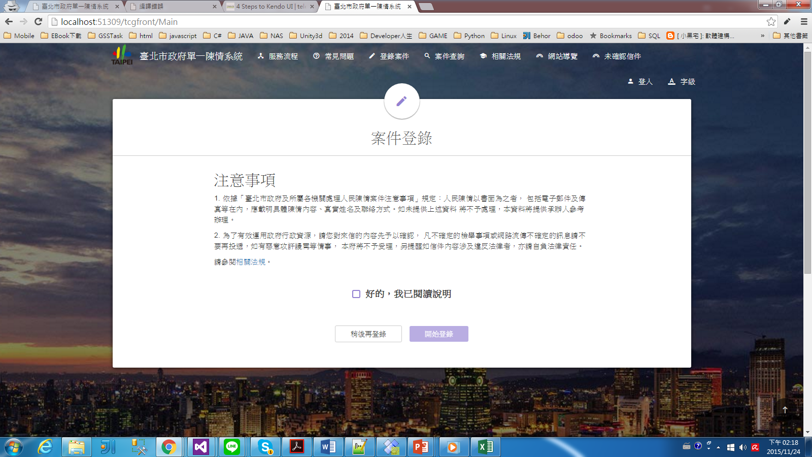
CSS
CSS stands for Cascading Style Sheets
Styles define how to display HTML elements

Slide 31

CSS
CSS Syntax
置放位置
inline <div style =“color:blue ; font-size:12px”> </div> (常見的)
embed<style type= "text/css" > </style>
Import <style type= "text/css" >@import </style>
external link<link rel=stylesheet type=“text/css” href=“external-stylesheet.css”>(推薦)
http://www.w3schools.com/css/demo_default.htm
參考 http://www.w3schools.com/cssref

Slide 32
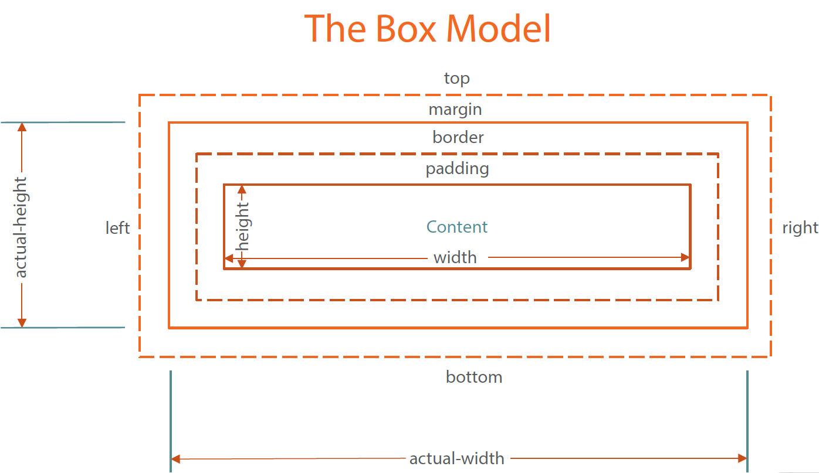
CSS

Slide 33
CSS
優先權
指定的層級越高或是越清楚越優先
頁面設定為優先
外部載入為次
最後設定的樣式將蓋過之前設定的樣式
!important 為最高優先
id 大於 class
Sample
go to W3C

Slide 34
CSS Selector
Exercise
請參考下列的連結去些改這個Exercise
參考

Slide 35


Slide 36
Introduct of JQuery
以網頁物件 DOM 為核心 ，沒有對 JavaScript 原生語言進行修改
JavaScript 函式庫 (Javascipt Framework)
寫出來的code比Javascript大量的減少許多
方便一些抓取DOM的Selectors 可以用(操作方式與CSS類似)

Slide 37
Basic JavaScript 操作
Base on it 的擴充語言很多
用途很廣泛
算是一種必學的語言
不嚴謹的語言
google console操作

Slide 38
Selectors
選取一個或多個DOM元素的簡化js方法
JQuery($) Ready
$( document ).ready( handler )
$().ready( handler ) (this is not recommended)
$( handler ) =>常用
取代<body onLoad="init()"/>
Onload vs Ready
取代js getElementsByXXX
$("a") => document.getElementsByTagName("a");
$("#a") => document.getElementById("a");
$(".a") => document.getElementsByClassName("a");
$("[name=a]") => document.getElementsByName("a");

Slide 39
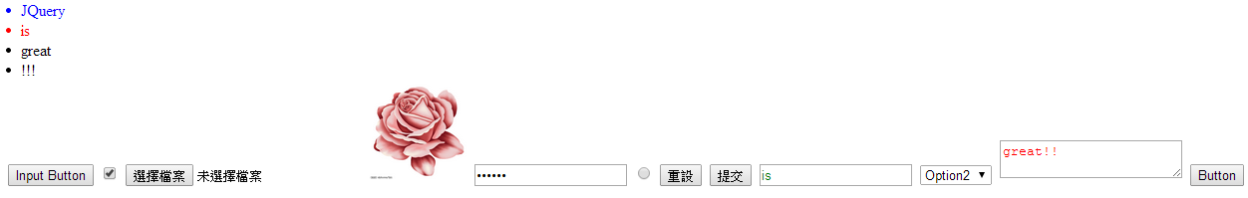
Exercise
Link

Slide 40
Event Handle
CallBack Function
var fun = function(){ xxxx} =>把fun當變數給別人去執行
Event handle
on (after jquery 1.7+)
$( "#members li a" ).on( "click", function( e ) {} );
$( document ).on( "click", "#members li a", function( e ) {} );
$( "#members" ).on( "click", "li a", function( e ) {} );
trigger
$( "#members li a" ).on("customer", function( e ) {} );
$( "#members li a" ).trigger("customer");

Slide 41


Slide 42
Introduction
Telerik Company
70+ jQuery-based UI widgets and 11 frameworks
Seamless AngularJS and Bootstrap integration
Web components support and mobile app
Offline data storage engine
Easy-to-use library with polished UI
Notes:
介紹簡單的Kendo 網站

Slide 43
Kendo Relation link
http://dojo.telerik.com/ (類似jsfiddle)
http://demos.telerik.com/kendo-ui/ (component demo)
http://docs.telerik.com/kendo-ui/introduction (官方教學)

Slide 44
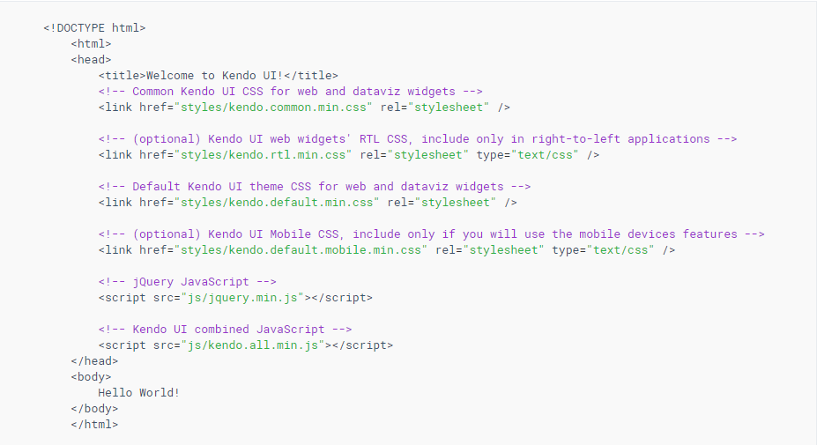
Include library

Slide 45

Include library
使用Kendo UI CDN Services
https://kendo.cdn.telerik.com/版本號/js或css/js或css元件名稱

Slide 46
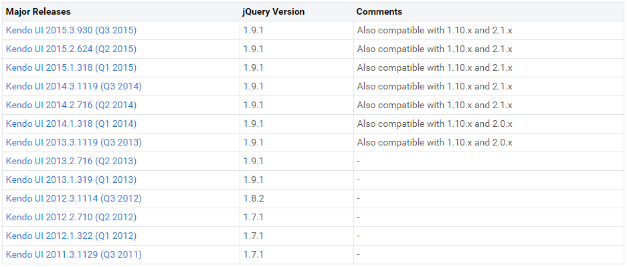
Include library
注意Kendo UI 所支援的版本號

Slide 47
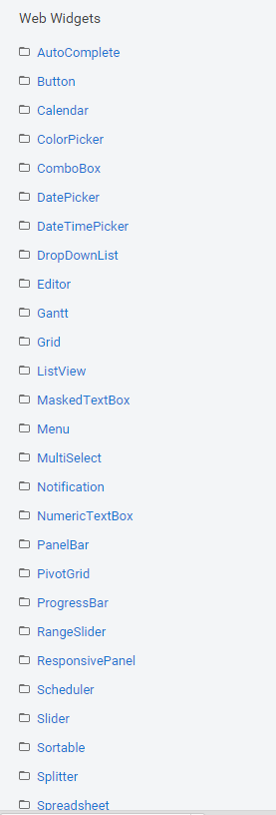
Web Widgets
基本的使用方式
定義一個dom (ex. <div>、<input>)
Selector.kendo+(Web Widgets Name)
Ex: $(“#id”).kendoButton();
設定相關的參數屬性讓這個widget動起來

Slide 48
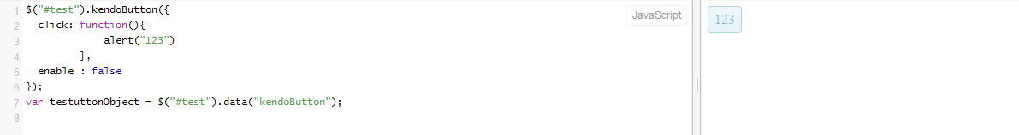
簡單的Kendo Button
kendoButton()
enable
click
icon
spriteCssClass
Grouping button
kendo.init(“#groupContainer”);
data-role=“button”( 為了少寫一些javascript)
Notes:
$("#test").kendoButton({
click: function(){
alert("123")
},
enable : false
});
var testuttonObject = $("#test").data("kendoButton");

Slide 49
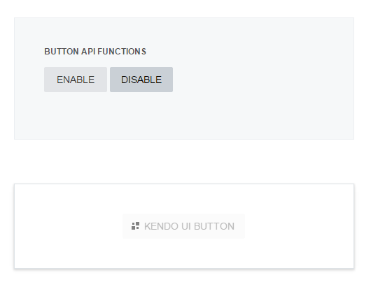
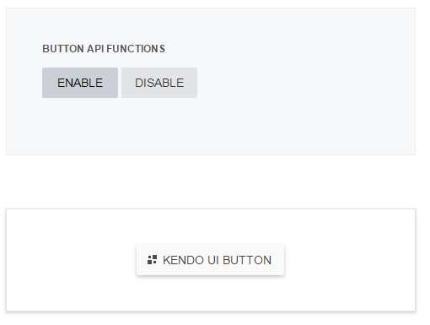
Exercise(10分鐘)
實做一個按鈕 可以操作主要button的enable

Slide 50
*Kendo Grid
優化HTML Table
基本的Grid CRUD
可以在local處理 也可以在remote
針對DataSource做處理
可以客製化欄位(template)

Slide 51
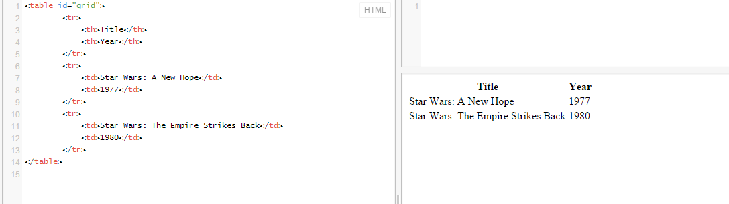
Kendo Grid
Html Table

Slide 52
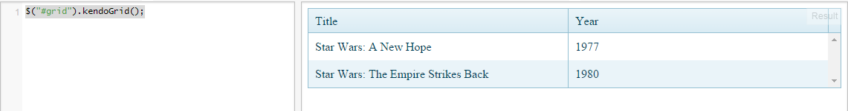
Kendo Grid
kendoGrid() 優化Table
利用DataSource 來bind kendoGrid
Notes:
var people = [ { firstName: "John",
lastName: "Smith",
email: "john.smith@telerik.com" },
{ firstName: "Jane",
lastName: "Smith",
email: "jane.smith@telerik.com" },
{ firstName: "Josh",
lastName: "Davis",
email: "josh.davis@telerik.com" },
{ firstName: "Cindy",
lastName: "Jones",
email: "cindy.jones@telerik.com" } ];
$("#grid").kendoGrid({
dataSource: people
});

Slide 53
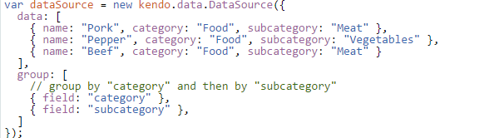
DataSource
在kendo裡面算是一個核心角色
是一個物件的資料結構
對Kendo UI上的data binding
$("#grid").data("kendoGrid").dataSource;
Notes:
var dataSource = new kendo.data.DataSource({
data: [
{ name: "Pork", category: "Food", subcategory: "Meat" },
{ name: "Pepper", category: "Food", subcategory: "Vegetables" },
{ name: "Beef", category: "Food", subcategory: "Meat" }
],
group: [
// group by "category" and then by "subcategory"
{ field: "category" },
{ field: "subcategory" },
]
});
dataSource.fetch(function(){
var view = dataSource.view();
console.log(view.length); // displays "1"
var food = view[0];
console.log(food.value); // displays "Food"
var meat = food.items[0];
console.log(meat.value); // displays "Meat"
console.log(meat.items.length); // displays "2"
console.log(meat.items[0].name); // displays "Pork"
console.log(meat.items[1].name); // displays "Beef"
var vegetables = food.items[1];
console.log(vegetables.value); // displays "Vegetables"
console.log(vegetables.items.length); // displays "1"
console.log(vegetables.items[0].name); // displays "Pepper"
});

Slide 54
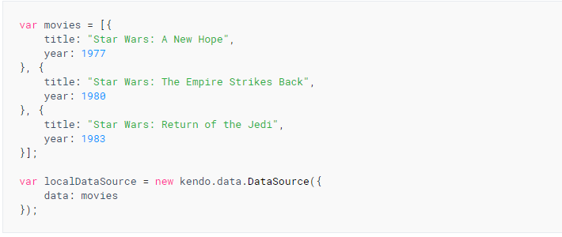
DataSource
Local data

Slide 55
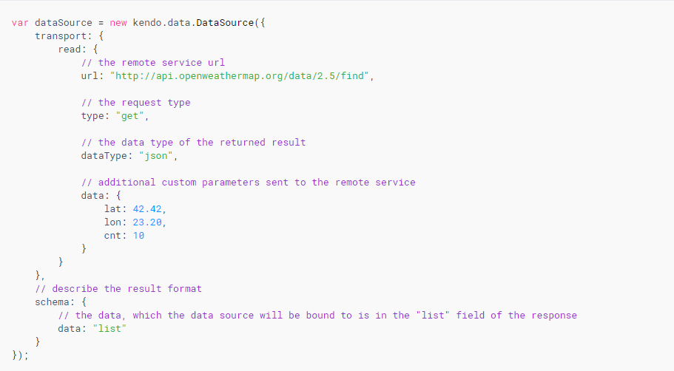
DataSource
Remote data
Notes:
$("#chart").kendoChart({
title: {
text: "Employee Sales"
},
dataSource: new kendo.data.DataSource({
data: [
{
employee: "Joe Smith",
sales: 2000
},
{
employee: "Jane Smith",
sales: 2250
},
{
employee: "Will Roberts",
sales: 1550
}]
}),
series: [{
type: "line",
field: "sales",
name: "Sales in Units"
}],
categoryAxis: {
field: "employee"
}
});

Slide 56
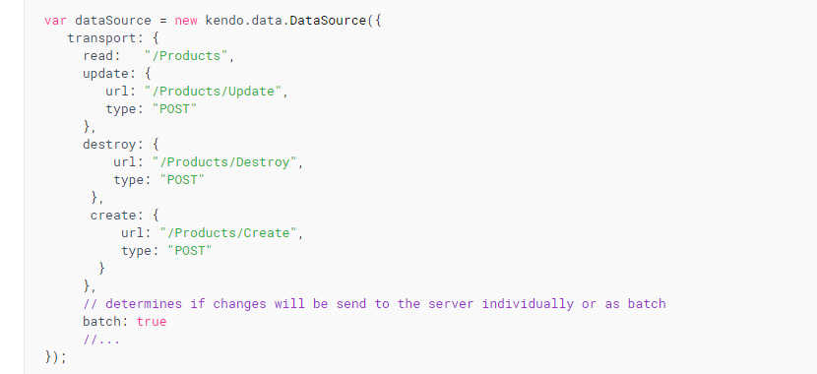
Kendo Grid
Remote CRUD

Slide 57
DataSource
read();
refresh();
destory();
empty();
view()

Slide 58
Kendo Grid
Demo link
DataSource API Reference

Slide 59
Kendo Other
kendo.toString(1234.5678, "00000")
數字的format
kendo.culture(“zh-TW");
kendo.toString(1234.567, "n");
kendo.toString(1234.567, "c0")
kendo.toString(1234.5678, "00000")
Combo Box
Date Picker
Notification

Slide 60
WorkShop 3
實作一個簡單的圖書館系統
要有 搜尋書籍、新增書籍、刪除書籍功能
要使用 Kendo Grid、DatePicker、DropDownList
資料存在 localStorage 裡面
Coding Guideline 要注意
加分題：Kendo Window、Kendo Validate

